Slide 1

Environment sustainability: study of air pollution
UMBC
CMSC 636
Udit Choudhary
Zeenat Ali

Slide 2
Objective
To help the user to visualize the increase and decrease of air pollution level
The study can be a basis to foresee the future pattern and the remedies that can be adapted to reduce the contamination of environment.
CMSC 636

Slide 3
Approach
Data Source
The data was collected for 7 sites of Maryland to study quality of air based on AQI (Air Quality Index) defined by US EPA (Environment Protection Agency)
5 pollutants were taken into account, viz. CO, NO2, Ozone, SO2, PM 2.5
Data was collected for 2 decades from 1999 to 2019
Data source:
https://www.epa.gov/outdoor-air-quality-data/download-daily-data
https://www.airnowtech.org/data
CMSC 636

Slide 4
Approach
Prototype
Interface 1:
The user can select the site from the dropdown.
CMSC 636

Slide 5
Approach
Prototype
Interface 2:
Latitude and longitude points for the site has been first plotted on the geospatial dimensions.
Concentration of pollutants like Nitrogen dioxide, carbon monoxide is plotted in map and the scale varies from green to red based on the increasing level of pollutants at the region.
CMSC 636

Slide 6
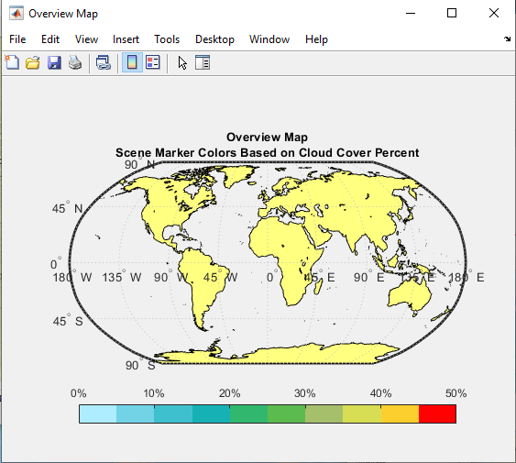
Approach
Reference scale of cloud cover percent
CMSC 636

Slide 7
Approach
Prototype
Interface 3:
An animated plot based on time series data shows the increase and decrease in level of pollution over a period of 2 decades.
CMSC 636

Slide 8
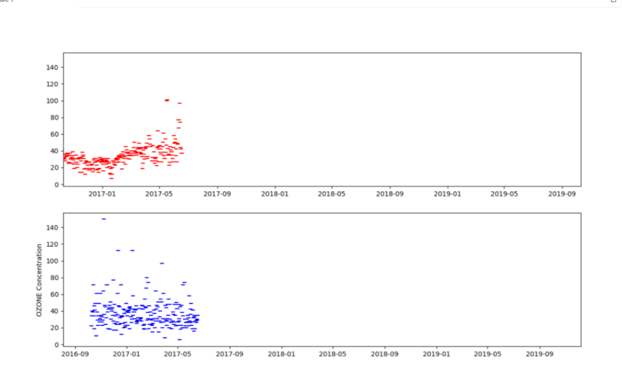
Approach
CMSC 636

Slide 9
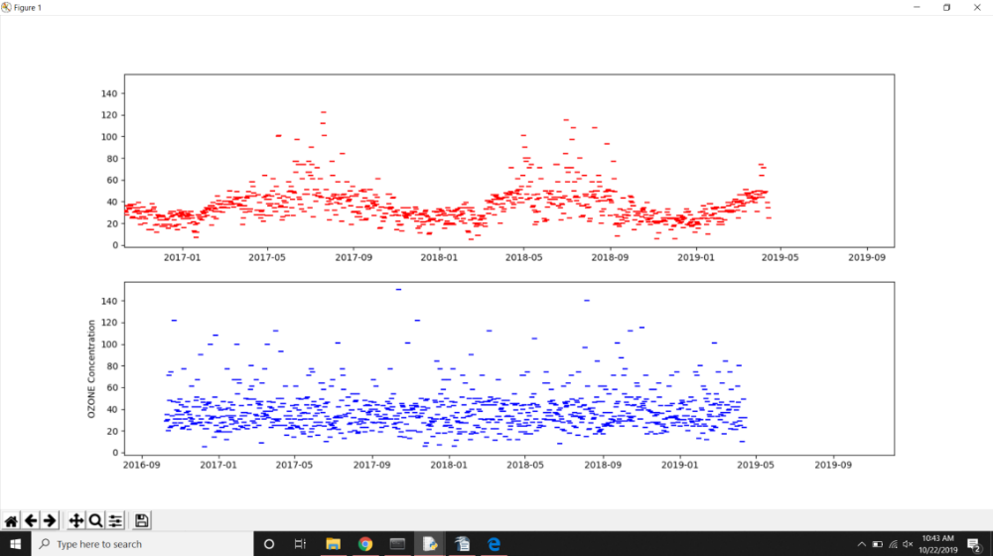
Approach
CMSC 636

Slide 10
Approach
Solution Design and Challenges
The initial geospatial map was built in MATLAB and the sites were plotted as bubbleplot based on their latitude and longitude attributes.
The animated graph is plotted using python libraries, viz. Tkinter, matplotlib, PIL
Later due to challenges in merging the python code with MATLAB, the geospatial map was moved to python using geopandas.
CMSC 636

Slide 11
Future Scope
Representation of activities that causes air pollution on those locations, what gases they release, how much impact does it have.
Future pattern: With incorporation of machine learning and data science, the scope of the project can be widened to include future patterns if the current activities continue.
Remedy: The study can be extended to visualize what remedies can be implemented to bring a change in the pattern of environment degradation.
CMSC 636

Slide 12
References
• Dua, D. and Graff, C. (2019). UCI Machine Learning Repository
[http://archive.ics.uci.edu/ml]. Irvine, CA: University of California, School of Information and Computer Science.
• https://www.mathworks.com/
• S. De Vito, E. Massera, M. Piga, L. Martinotto, G. Di Francia, On field calibration of an electronic nose for benzene estimation in an urban pollution monitoring scenario, Sensors and Actuators B: Chemical, Volume 129, Issue 2, 22 February 2008, Pages 750-757, ISSN 0925-4005.
• https://public.tableau.com/en-us/s/
• J. D. Hunter, "Matplotlib: A 2D Graphics Environment", Computing in Science & Engineering, vol. 9, no. 3, pp. 90-95, 2007
• Chen, P. J Image Video Proc. (2019) 2019: 42. https://doi.org/10.1186/s13640-019-0443-6
CMSC 636

Slide 13
Questions
CMSC 636

Slide 14
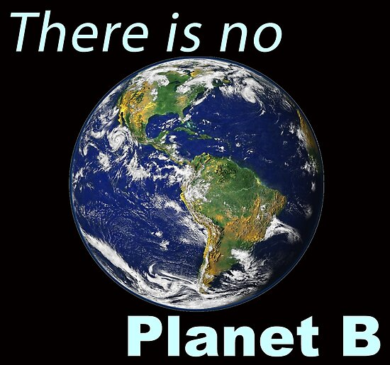
CMSC 636

